Slide 1
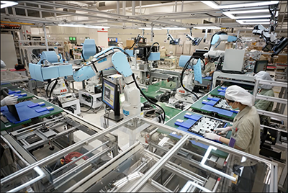
GROUP 4
Efficient application of optimization algorithms for balancing human robot collaborative assembly lines

Slide 2
LITERATURE REVIEW:
PAPERS REVIEWED TILL DATE: (Included in a separate word file)
Parames Chutima. (2020). A comprehensive review of robotic assembly line balancing problem. https://doi.org/10.1007/s10845-020-01641-7
Amir Nourmohammadi, Masood Fathi, Amos H.C. Ng. (2021). Balancing and scheduling assembly lines with human-robot collaboration tasks. https://doi.org/10.1016/j.cor.2021.105674
Ying Sun, Yuelin Gao. (2019). A Multi-Objective Particle Swarm Optimization Algorithm Based on Gaussian Mutation and an Improved Learning Strategy. doi:10.3390/math7020148
Parsopoulos, Konstantinos & Vrahatis, Michael. (2008). Multi-objective particle swarm optimization approaches. 10.13140/2.1.5189.4721.
Mohd Fadzil Faisae Ab Rashid, Windo Hutabarat, Ashutosh Tiwari. (2016). Multi-objective discrete particle swarm optimisation algorithm for integrated assembly sequence planning and assembly line balancing. DOI: 10.1177/0954405416673095

Slide 3
N. Boysen, P. Schulze and A. Scholl. (2021). Assembly line balancing: What happened in the last fifteen years? European Journal of Operational Research, https://doi.org/10.1016/j.ejor.2021.11.043
Tamás Koltai, Imre Dimény, Viola Gallina, Alexander Gaal, Chiara Sepe, An analysis of task assignment and cycle times when robots are added to human-operated assembly lines, using mathematical programming models, International Journal of Production Economics, Volume 242, 2021, 108292, ISSN 0925-5273, https://doi.org/10.1016/j.ijpe.2021.108292.
Nicole Berx, Wilm Decré, Ido Morag, Peter Chemweno, Liliane Pintelon, Identification and classification of risk factors for human-robot collaboration from a system-wide perspective, Computers & Industrial Engineering, Volume 163, 2022, 107827, ISSN 0360-8352, https://doi.org/10.1016/j.cie.2021.107827.

Slide 4
THE ALGORITHM USED (PSO)
Step 1:
Generate the swarm with position and velocity vectors and initialize the p_best and g_best.
Step 2:
Update the swarm using certain methods and update p_best and g_best in each iteration.
Step 3:
Decode the obtained solution from PSO and print the solution.

Slide 5
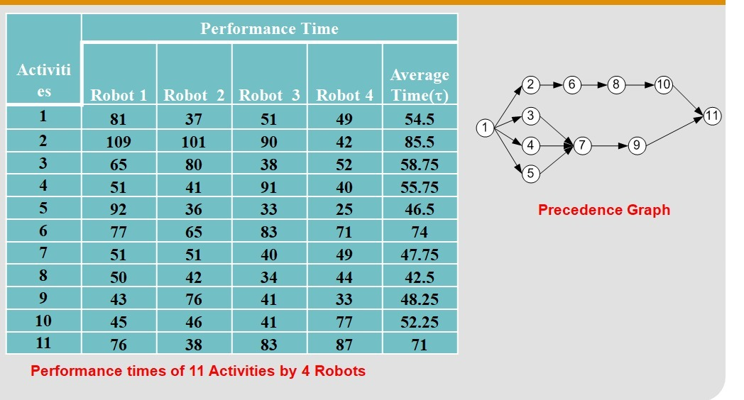
INPUT DATA USED (TASK TIME AND PRECEDENCE GRAPH)
This is the input data used that represents the task times of 4 robots for given 11 different activities that follow a certain precedence relation as shown in the network diagram.

Slide 6
INPUT DATA USED (SETUP TIME)
ACTIVITIES
R
O
B
O
T
18 | 15 | 13 | 18 | 16 | 16 | 10 | 11 | 17 | 14 | 17
10 | 11 | 16 | 16 | 14 | 16 | 10 | 18 | 14 | 13 | 20
19 | 14 | 13 | 18 | 19 | 18 | 20 | 14 | 19 | 17 | 17
11 | 13 | 13 | 15 | 11 | 12 | 11 | 13 | 19 | 12 | 14
This is the input data used that represents the setup times of 4 robots for given 11 different activities.
This setup time is added with the task time for all the robot that performs that particular task. This setup time includes the time for setting up the robot, fixing the tool, etc..,

Slide 7
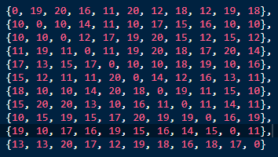
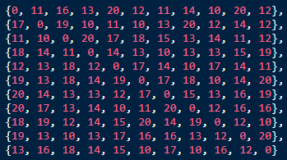
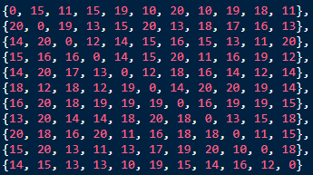
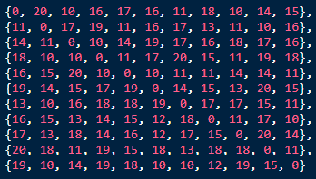
INPUT DATA USED (SEQUENCE DEPENDENT TIME)
R
O
B
O
T
1
R
O
B
O
T
2
R
O
B
O
T
3
R
O
B
O
T
4

Slide 8
FORMULATING THE ALGORITHM (MODIFIED DPSO)
For implementing the standard PSO for a discrete problem, some assumptions and formulations are made such as,
Population matrix consists of feasible sequences.
Velocity matrix consists of randomly generated numbers ranging from [0 - no_of_tasks].
Updation of the swarm is done according to the rules that is mentioned in upcoming slides.
For encoding purpose, only the sequence array is used.
For decoding purpose, the robots assigned and the tasks performed in each station is determined by knowing the optimal cycle time.
The addition of setup times and sequence dependent time is used to make the problem more suitable for industrial purposes.
Setup time is added with the task time for each task performed by the robot.
Sequence dependent time is added only for the tasks that are not first in the station as these times are dependent on the previously performed tasks(first performed task in each station by the robot has no previous task).

Slide 9
OBJECTIVE FUNCTION CALCULATION USING CONSECUTIVE METHOD (CYCLE TIME)
For calculating the cycle time of a particular sequence generated by PSO algorithm, consecutive method algorithm is used. The working of this algorithm is:
Cycle time is initially fixed with a value by summing up the minimum task time of all robots.
For each station, the sequence is tried with all the available robots with given number of stations and the cycle time that is found previously.
In each iteration, if the found cycle time is not feasible, the cycle time is incremented.
This step is repeated until a feasible cycle time is found which is the optimal cycle time for the given sequence.
The addition of sequence dependent time and setup time is also included in the cycle time to make the solution obtained more feasible and realistic for industrial usage purpose.
The sequence dependent time is added because of the precedence constraints.
Sequence dependent times is dependent on the task that is performed before the current task for a particular robot in that station.

Slide 10
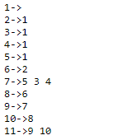
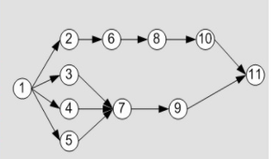
SEQUENCE GENERATION USING ADJACENCY LIST
For generating sequence, a precedence matrix is generally used in many papers.
But in our proposed method, we use adjacency list that stores the precedence relation efficiently and helps in generation of sequence that satisfied these relations.
The algorithm is as:
First a available set is created with the tasks that has no precedence tasks.
Then one task is selected randomly from that set and the tasks following it are added in the available set.
This step is repeated until all the tasks are assigned and available set is empty.
The use of adjacency list is very helpful in implementing this algorithm.
Adjacency holds the data as shown in this example.

Slide 11
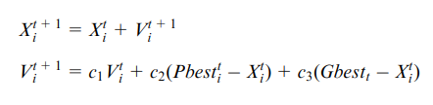

POPULATION UPDATION USING MODIFIED DPSO METHOD
For implementing the modified DPSO method, the velocity vector is taken as an array of integers ranging from [0 - no.of.tasks] instead of velocity pairs that is used in most of the paper.
These velocity vectors are used to update the population using certain conditions. They are,
SUBTRACTION (position - position)
Let X1,t = [x1,1, x1,2, x1,3, x1,4, x1,5, x1,6, x1,7]
X2,t = [x2,1, x2,2, x2,3, x2,4, x2,5, x2,6, x2,7]
V1,t =X1,t - X2,t
In this case, if x1 and x2 in the jth position are equal, then v1= 0. Otherwise, v1=x1. For example,

Slide 12


ADDITION (position + velocity)
If the jth element of velocity (vj) is equal to 0, the jth position value (xj,t) is inserted into the jth element of the new position (xj,t+1).
In the meantime, if vj is nonzero and does not appear in the new position, then xj,t+1=vj. Otherwise, xj,t+1 is equal to 0. For example,
ADDITION (velocity + velocity)
For new velocity, V=V1 + V2, the jth element of V can be derived as follows,
Vj = v1,j IF v1,j!=0 && v2,j!=0
Vj = v1,j IF v1,j!=0 && v2,j==0
Vj = v2,j OTHERWISE
For example,

Slide 13


MULTIPLICATION (coefficient * velocity)
This operation can be represented as V2= c * V1, where coefficient c is lies in[0, 1] is used to control the effect of V1 that inherit in V2.
For this purpose, a random number, r that lies in [0, 1] is generated. IF r< c, v2=v1, ELSE v2= 0.
For example,
REPAIR FUNCTION
This function is used to repair a sequence which does not follow the precedence relation.
This does multiple swaps and replacements so that the given sequence is in bounds with the precedence relation.
For example,

Slide 14
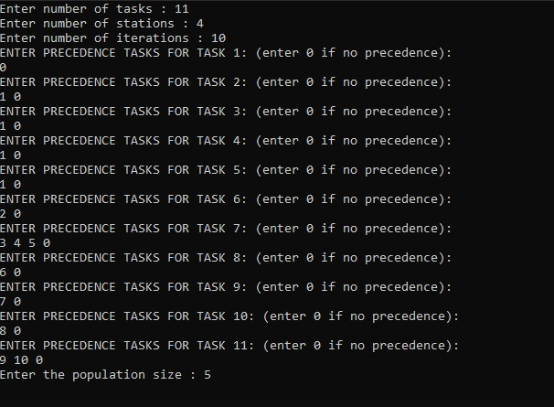
RESULTS OBTAINED

Slide 15
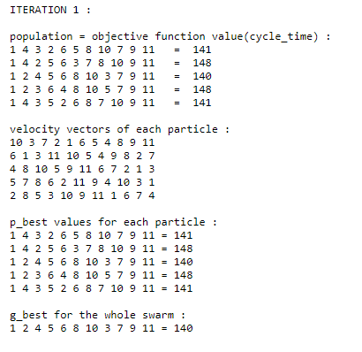
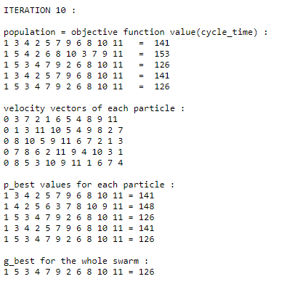
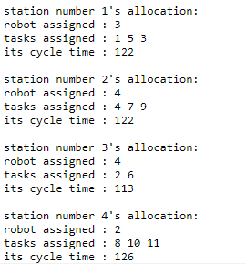
WITHOUT TAKING SEQUENCE DEPENDENT AND SETUP TIMES

Slide 16
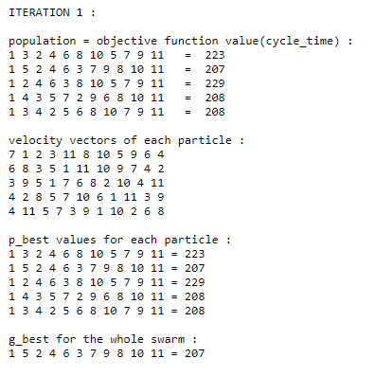
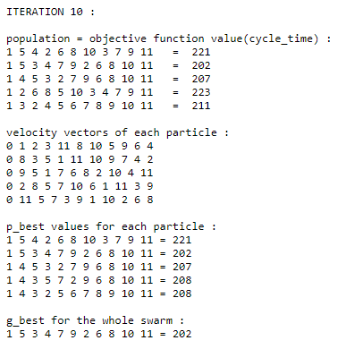
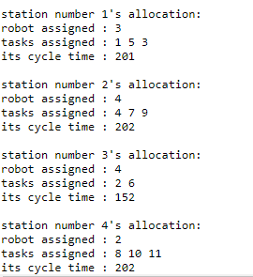
TAKING SEQUENCE DEPENDENT AND SETUP TIMES

Slide 17

ENERGY FUNCTION CALCULATION CONSIDERING ERGONOMICS OF HUMANS
For calculating the energy spent by robot, the simple equation is,
Energy used by robot i for performing task j = energy required for that robot to perform that task * time taken to complete the task
Energy used by human to perform task i,
Here the energy spent for movement is not considered as the human is assigned for one station and does not move to another stations.
The above mentioned formulation is taken from the paper,
Daria Battini, Xavier Delorme, Alexandre Dolgui, Alessandro Persona & Fabio Sgarbossa (2016) Ergonomics in assembly line balancing based on energy expenditure: a multi-objective model, International Journal of Production Research

Slide 18
Further work to be done:
Implementing the above ASP & ALB DPSO algorithms for BOTH HUMAN & ROBOT allocation to workstations, by considering FLEXIBLE-ECONOMICAL USER-INPUT constraints (robot types and their respective quantity to be used as realistic approaches) in different case scenarios like
Only human workforce (already implemented)
Either human / robot in a workstation
Both human & robots in a workstation.
Implementing the above ASP/ALB problem by using an updated TLBO algorithm. We would try to derive and propose an updation method for both the teacher and learner phase expressions for dealing with discrete population (task numbers) rather than the traditional “continuous real space domain”.
Further literature review of relevant topics.

